Slide 1
Long-term vegetation progression simulation
Floris Leysen
Notes:
Good morning.
Thanks for joining.
What does it mean?

Slide 2
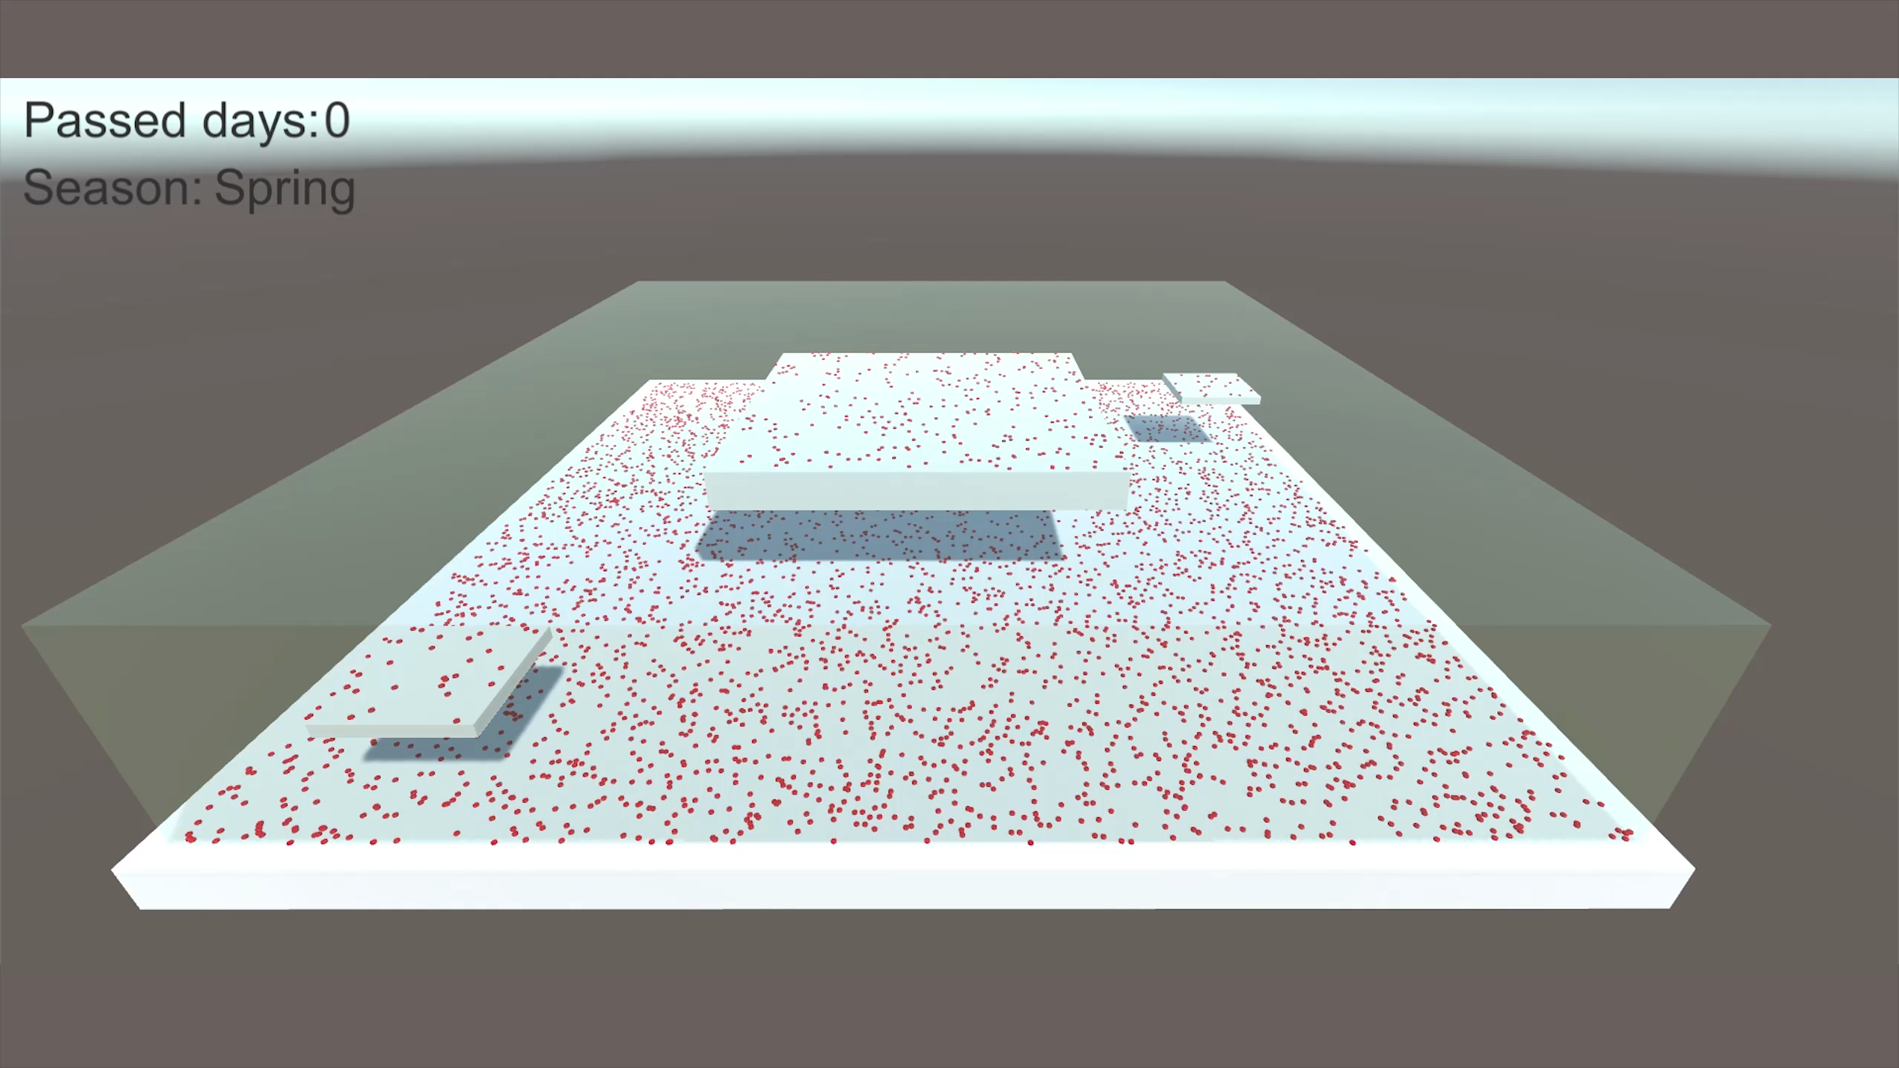
Notes:
Empty filled up
Changes and evolves
Multiple factors: shadow, seasons, rules

Slide 3
What and why?
Unity framework
Predefined environment
Plants determine own rules
Allows passing of time
Unexplored niche
Notes:
Season length, which plants, seed count
System can provide info
Intervals or requested
Unreal tool ignores shadow
Long time passed in-game

Slide 4
Research – model, plants, surfaces
Agent-based model
Individuals < whole
How plants work
Grasses are universal
Allow positioning, tracking
Meshes’ triangles
Complex, slow
Raycasting
No tracking
Grid cells
Easy tracking
Combines with raycasts
Notes:
Title T

Slide 5
Research – light & optimization
Allow data access
Runtime shadowmap
Single light
Lightmap baking
Lightmap highly variable
Shadow mask better
Average shadow time
Place reference lights
Notes:
Title T

Slide 6
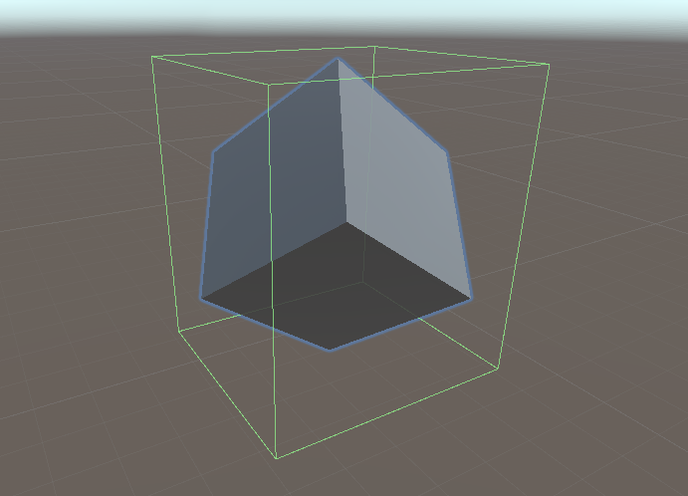
Case study: surfaces
Unity grid component
Two layers
Ray from top
Problem: irregular x-z plane
Dictionary

Slide 7
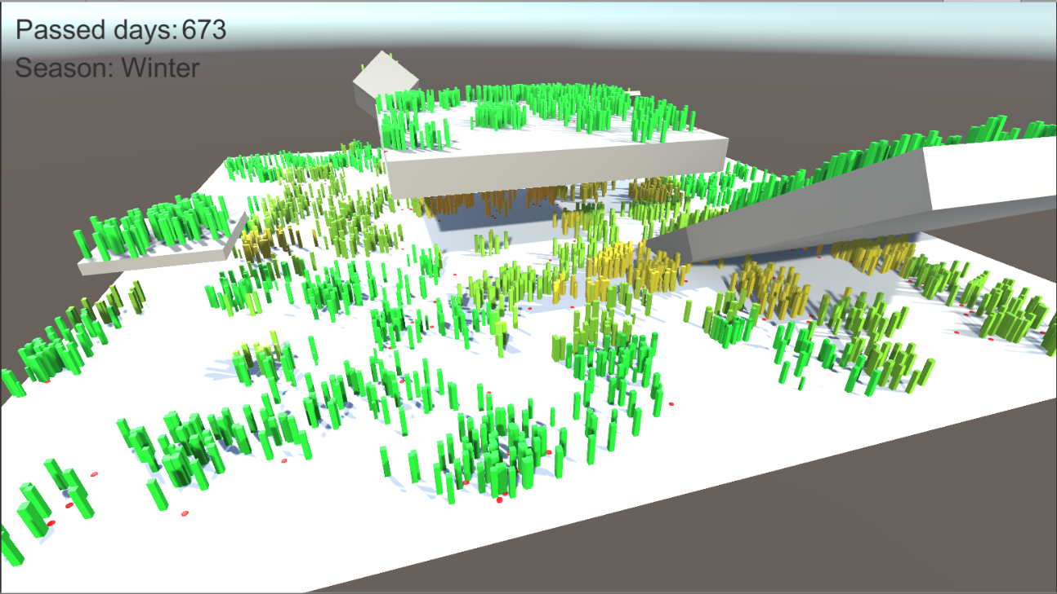
Case study: shadows
Manually request bake
Assetpostprocessor convenient
Light count bitmask
Averaging values
Plants receive shadowfactor

Slide 8
Questions

